Slide 1
Polymorphism

Slide 2
Lecture Objectives
To understand the concept of polymorphism
To understand the concept of static or early binding
To understand the concept of dynamic or late binding

Slide 3
Polymorphism
Polymorphism comes from Greek meaning “many forms.”
In Java, polymorphism refers to the dynamic binding mechanism that determines which method definition will be used when a method name has been overridden.
Thus, polymorphism refers to dynamic binding.

Slide 4
Polymorphism (Cont’d)
Can treat an object of a subclass as an object of its superclass
  A reference variable of a superclass type can point to an object of its subclass
  Person name, nameRef;
  PartTimeEmployee employee, employeeRef;
  name = new Person("John", "Blair");
  employee = new PartTimeEmployee("Susan", "Johnson",
  12.50, 45);
  nameRef = employee;
  System.out.println("nameRef: " + nameRef);
  nameRef: Susan Johnson wages are: $562.5

Slide 5
Polymorphism (Cont’d)
Late binding or dynamic binding (run-time binding):
  Method to be executed is determined at execution time, not compile time
Polymorphism: to assign multiple meanings to the same method name
Implemented using late binding

Slide 6
Polymorphism (Cont’d)
The reference variable name or nameRef can point to any object of the class Person or the class PartTimeEmployee
These reference variables have many forms, that is, they are polymorphic reference variables
They can refer to objects of their own class or to objects of the classes inherited from their class

Slide 7
Polymorphism (Cont’d)
Can declare a method of a class final using the keyword final
If a method of a class is declared final, it cannot be overridden with a new definition in a derived class
public final void doSomeThing(){
//...
}

Slide 8
Polymorphism (Cont’d)
Can also declare a class final using the keyword final
If a class is declared final, then no other class can be derived from this class
Java does not use late binding for methods that are private, marked final, or static

Slide 9
Polymorphism (Cont’d)
You cannot automatically make reference variable of subclass type point to object of its superclass
Suppose that supRef is a reference variable of a superclass type and supRef points to an object of its subclass:
  Can use a cast operator on supRef and make a reference variable of the subclass point to the object
  If supRef does not point to a subclass object and you use a cast operator on supRef to make a reference variable of the subclass point to the object, then Java will throw a ClassCastException—indicating that the class cast is not allowed

Slide 10
Polymorphism (Cont’d)
Operator instanceof: determines whether a reference variable that points to an object is of a particular class type
This expression evaluates to true if p points to an object of the class BoxShape; otherwise it evaluates to false
p instanceof BoxShape

Slide 11
Polymorphism (Cont’d)
Interface variable holds reference to object of a class that implements the interface
Measurable x;
Note that the object to which x refers doesn't have type Measurable; the type of the object is some class that implements the Measurable interface
x = new BankAccount(10000);
x = new Coin(0.1, "dime");
Continued…

Slide 12
Polymorphism (Cont’d)
You can call any of the interface methods:
Which method is called?
double m = x.getMeasure();

Slide 13
Polymorphism (Cont’d)
Depends on the actual object.
If x refers to a bank account, calls BankAccount.getMeasure()
If x refers to a coin, calls Coin.getMeasure()
Polymorphism (many shapes): Behavior can vary depending on the actual type of an object
Continued…

Slide 14
Polymorphism (Cont’d)
Called late binding: resolved at runtime
Different from overloading; overloading is resolved by the compiler (early binding)

Slide 15
Dynamic Binding
Different objects can invoke different method definitions using the same method name.
The type of object being referenced at the time of the method call, not the type of reference that was declared, determines which method is invoked.
For example, if the reference b references a Box object and the reference t references a Triangle object, b and t invoke different definitions of the method drawAt() even of b and t are declared to be of type Figure.

Slide 16
Dynamic Binding (Cont’d)
Consider the following example:
  Figure f;
  Box b = new Box(1, 4, 4);
  f = b;
  f.drawAt(2);
  Triangle t = new Triangle(1,2);
  f = t;
  f.drawAt(2);

Slide 17
Dynamic Binding (Cont’d)
The method drawAt() is inherited from class Figure and is not overridden.
But, method drawHere() is invoked within the definition of method drawAt(), and method drawHere() is overridden.
The type of object referred to by f determines which method drawHere() is invoked.

Slide 18
Type Checking and Dynamic Binding
Recall that an object reference to an ancestor class can refer to an object of a descendant class.
However, you can invoke only a method in class Person with the variable p.
  Employee e = new Employee();
  Person p;
  p = e;

Slide 19
Type Checking and Dynamic Binding (Cont’d)
However, if a method is overridden in the class Employee, and variable p references an Employee object, then the method in class Employee is used.
The variable determines what methods can be used, but the type referenced by the object determines which definition of the method will be used.

Slide 20
Type Checking and Dynamic Binding (Cont’d)
To use a method name in the class Employee with an object named by the variable p of type Person, use a type cast.
Example:
  Employee e = (Employee)p;
  e.setEmployeeNumber(5678);

Slide 21
Type Checking and Dynamic Binding (Cont’d)
However, even a type cast cannot fool Java!
Example:
will use the definition of the method drawHere() given in class Box, not the definition of drawHere() given in class Figure.
  Box b = new Box (1, 4, 4);
  Figure f = (Figure)b;
  f. drawHere()

Slide 22
Type Checking and Dynamic Binding (Cont’d)
You are unlikely to assign an object of a descendant type to a variable of a parent type, at least not directly.
But, such an assignment can occur indirectly by providing an argument of a descendant type for a method that has a parameter of an ancestor type.

Slide 23
Dynamic Binding with the toString() Method
Recall the method toString() typically is used to prepare and return a string, describing an object, for output to the screen.
The name of this method can be omitted, thanks to dynamic binding, because one definition of method println() expects a single argument of type Object which it uses to invoke the method toString() associated with the object.

Slide 24
Subtle Difference
Dynamic binding refers to the process carried out by the computer.
Polymorphism can be thought of as something objects do.
Polymorphism, encapsulation, and inheritance, and considered to be the main features of object-oriented programming.

Slide 25
A Better equals() Method
Sometimes the method equals() from class Object is overloaded when it should have been overridden.
  This occurs when its parameter is not of type Object.
Usually, this is all right.

Slide 26
A Better equals() Method (Cont’d)
But, if the method equals() is called with an object of class Object as its argument, the method equals() from class Object will be invoked.
The problem is fixed by changing the formal parameter in the overriding method so that it is a parameter of type Object.

Slide 27
A Better equals() Method (Cont’d)
However, this allows the argument to be any type of object, which can produce a run-time error.
But, we can determine if an object is of the correct type using:
Finally, we should return false when comparing an object to a null reference.
Object instanceof Class_Name

Slide 28
A Better equals() Method (Cont’d)
The improved equals() method:
public boolean equals(Object otherObject) {
if(otherObject == null)
return false;
else if(!(otherObject instanceof Student))
return false;
else {
Student otherStudent = (Student) otherObject; // Downcast!!
return (this.studentNumbemer == otherStudent.studentNumber));
}
}

Slide 29
Benefits of Polymorphism
Polymorphism enables programmers to deal in generalities and let the execution-time environment handle the specifics. Programmers can command objects to behave in manners appropriate to those objects, without knowing the types of the objects (as long as the objects belong to the same inheritance hierarchy).

Slide 30
Benefits of Polymorphism (Cont’d)
Polymorphism promotes extensibility: Software that invokes polymorphic behavior is independent of the object types to which messages are sent. New object types that can respond to existing method calls can be incorporated into a system without requiring modification of the base system. Only client code that instantiates new objects must be modified to accommodate new types.

Slide 31
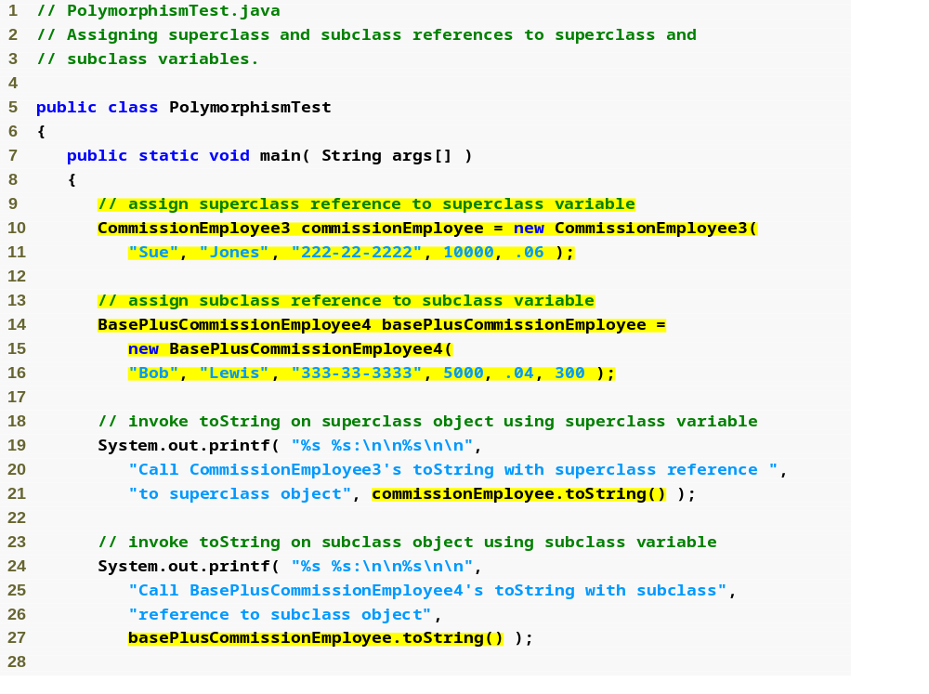
Testing Polymorphism
Typical reference assignments

Slide 32
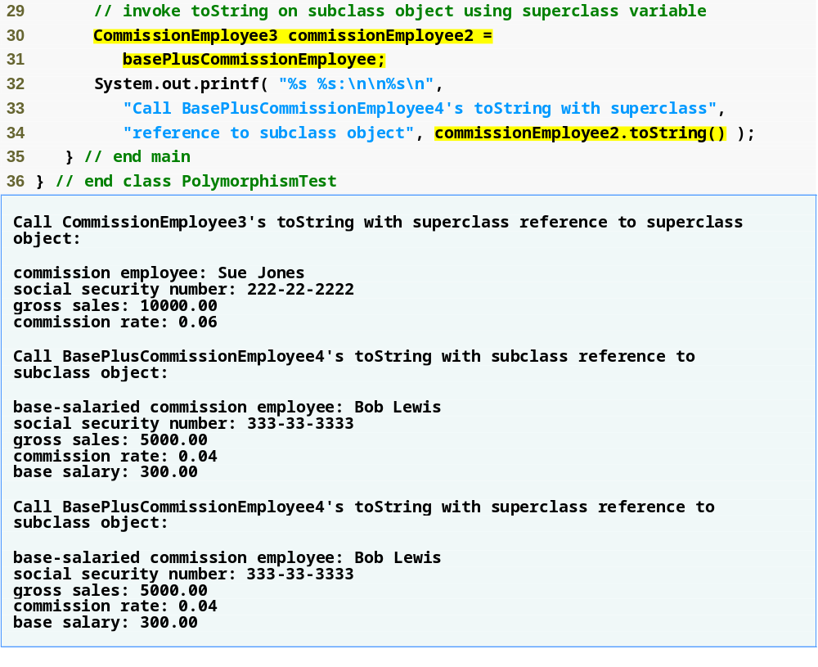
Testing Polymorphism (Cont’d)
Assign a reference to a basePlusCommissionEmployee object to a CommissionEmployee3 variable
Polymorphically call basePlusCommissionEmployee’s toString method

